Slide 1



Touchless screen using Leap Motion
Group 8
Napat Traikityanukul 59090011
HCI 2018

Slide 2
Description
The touch screen display provides a greater flexibility to user but after some years touch screen display becomes less sensitive which causes failure of touch on touch screen display. If we use a screen protector still dirty marks present on the display to avoid this problem a simple user interface for touch less control of electrically operated equipment is being developed.

Slide 3
Output
Moving cursor
Scrolling up/down
Clicking button

Slide 4
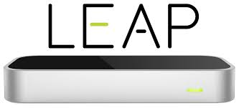
Hardware
z
z

Slide 5
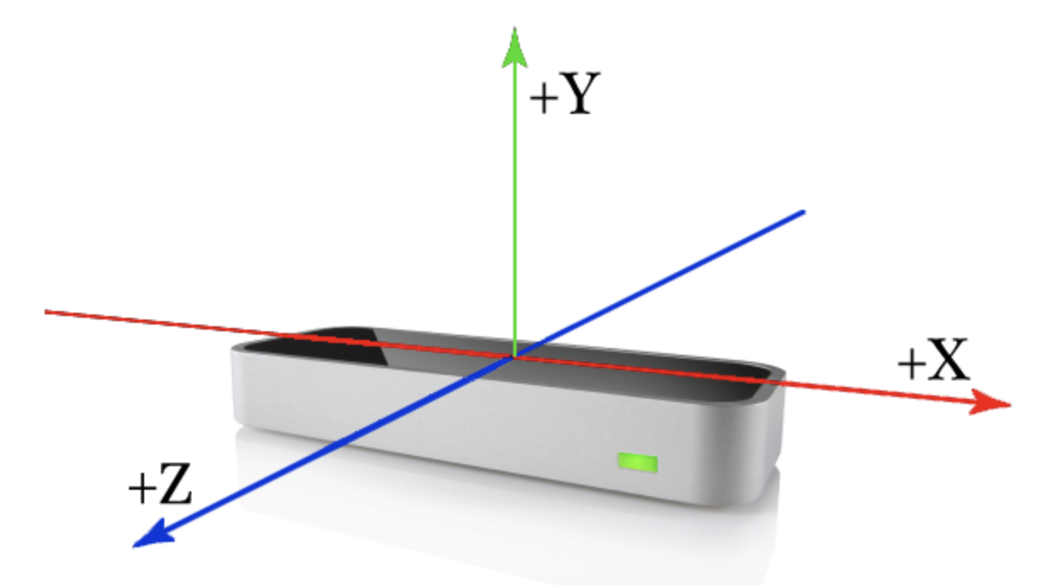

Slide 6
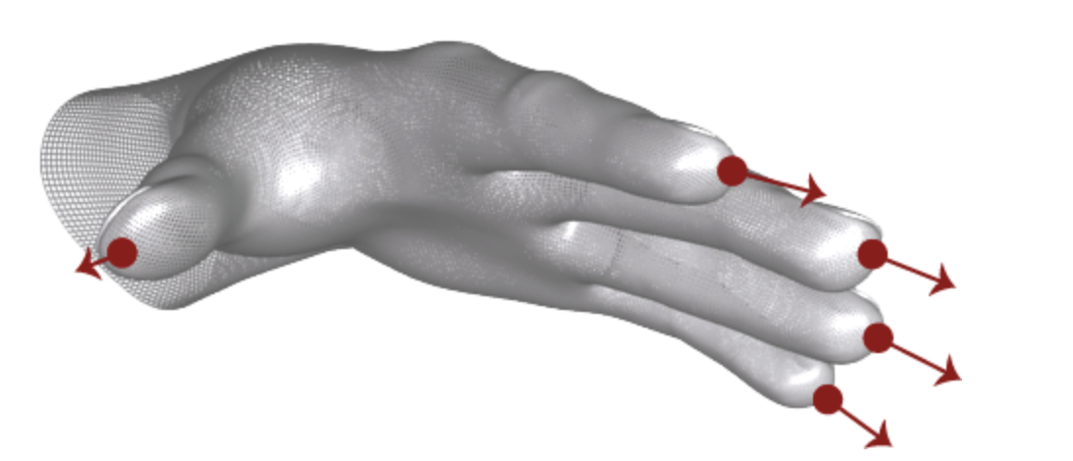
z
z

Slide 7
Software

Slide 8


Slide 9
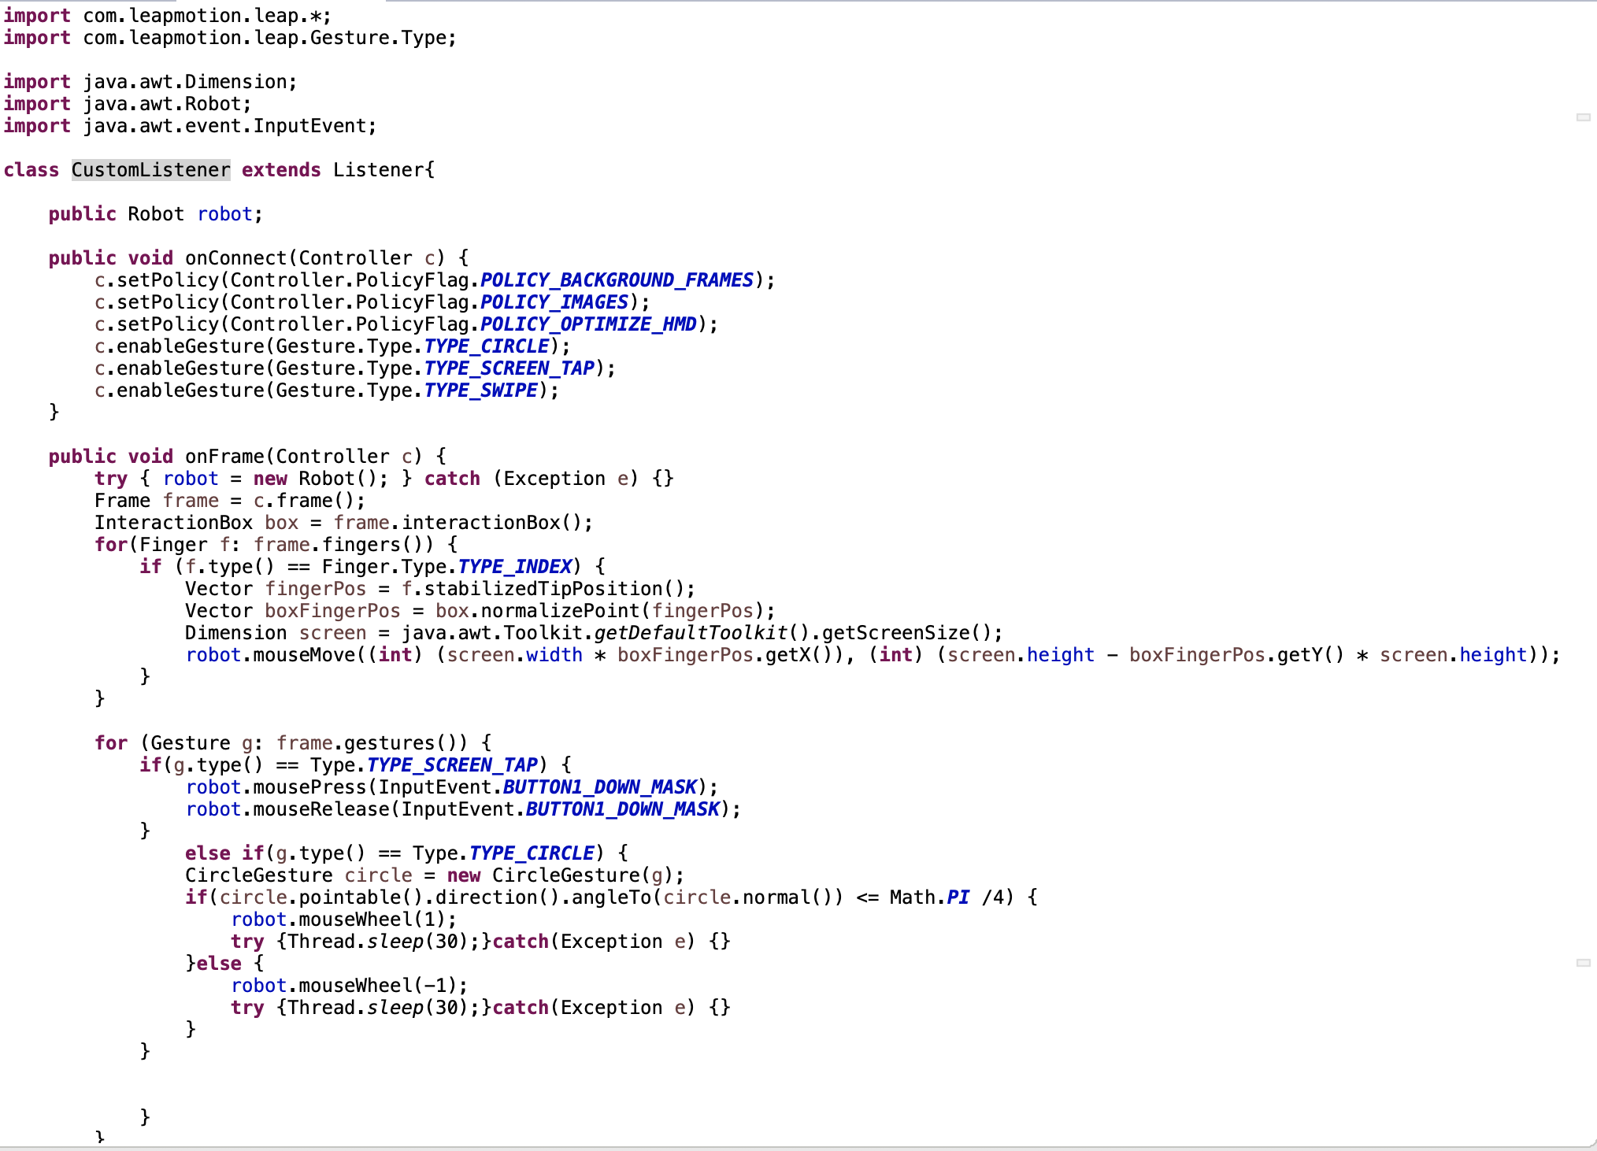

Slide 10
Discussion
First try, can not do in Back-ground mode.
Clicking Button can not do accurately.
Scrolling page , too fast in the first time.
Moving cursor is not quite stable in the background mode.

Slide 11
Acknowledge
Dr. Montri Phothisonothai - Professor of HCI course.
https://docs.oracle.com/javase/7/docs/api/java/awt/package-summary.html
https://developer-archive.leapmotion.com/documentation/java/index.html
https://developer-archive.leapmotion.com/documentation/java/api/Leap.Controller.html

